Slide 1
Term Project Milestone 3
Presented by Vidya Praveen
Course: Introduction to Data Science
Exercise: 9.3
Instructor: Neerja Sahu
Due Date: 5/15/2022

Slide 2
Assignment: Finalize your PowerPoint presentation with your topic, the information you found in your research, assumptions you have made, ethical concerns, etc. You should have at least 5-10 slides that provide an overview of your question or theory, along with all the required work that would need to be done to answer or prove/disprove your theory. You should also include some visualizations or evidence of the search engine data you researched.
The topic I had chosen to research was:
Divorce rates across US - Does the lifestyle or geographic location has any impact.
I wanted to research and know if a busy lifestyle leads to more divorce or if the demographics, the society has any impact on the divorce rate, since I feel, though it is just between husband and wife, the society, the culture, also play a role.

Slide 3
My Action Plan
In order to analyze my topic, I decided to first gather data. After some brainstorming, I decided to collect data about Divorce rate in US, based on different parameters.
The main parameters were :
State Wise
Cause
Ethnicity /Culture
Occupation
Age

Slide 4
Facts and assumptions made
Once I started to search for reports about Divorce rates, I realized that there is no, one central repository or system, where Divorces are recorded and tracked, unlike Birth or Death.
Each state has their own guidelines for recording and reporting the Divorce rates and some states don’t report at all.
Most of the reports available are based on surveys. These are considered, the valid sources for analysis.
I am doing this project with the assumption that all the data that I was able to collect are all valid data.

Slide 5
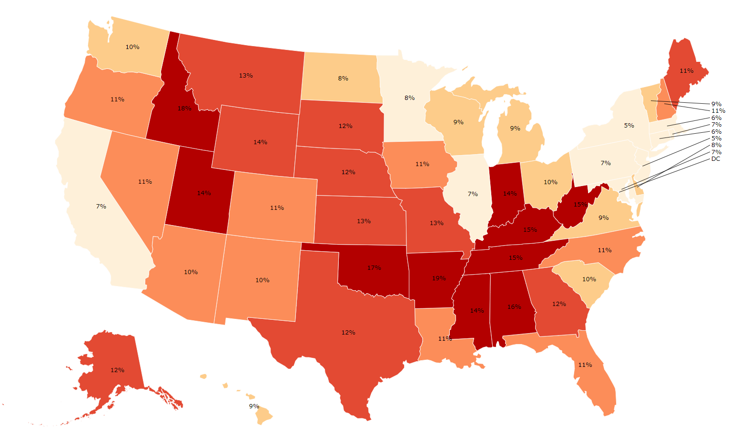
Divorce rate by State The findings from the data is that Divorce rate vary dramatically from state to state. The lowest divorce rate by state occurs in Illinois, Maine, New York, New Jersey and Louisiana. Conversely, the states with the highest divorce race are Arkansas, Nevada and Oklahoma

Slide 6
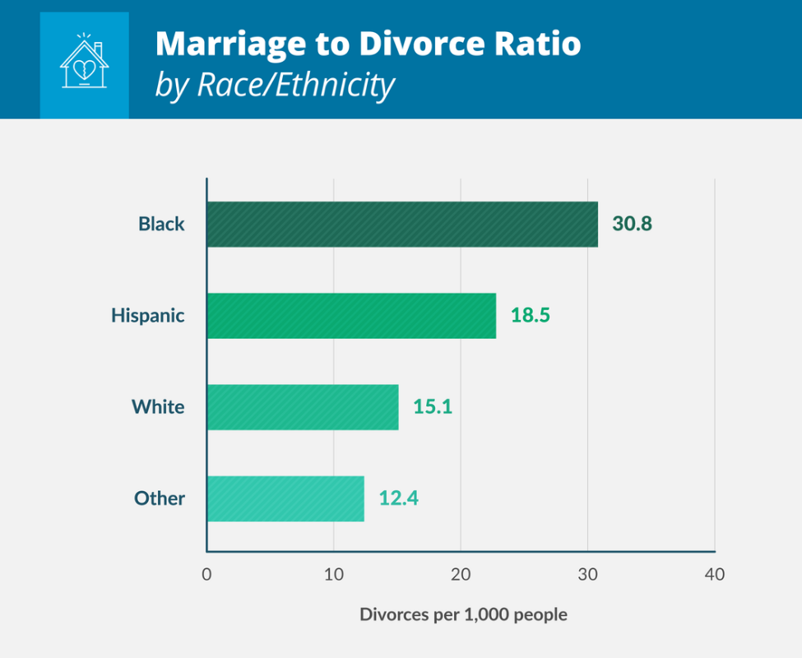
Divorce rate by Ethnicity The findings from the data is that Divorce rate vary dramatically based on ethnicity/culture. The lowest divorce rate is seen in Asian culture and the highest divorce rate is seen in black

Slide 7
Divorce rate by Ethnicity Cont’d
The groups with the most prolific experience of marriages ending in divorce are those aligned with a non-Christian faith (38 %), African-Americans (36 %), and people who consider themselves to be liberal on social and political matters (37 %).
Among the population segments with the lowest likelihood of having been divorced subsequent to marriage are Catholics (28 %), evangelicals (26 %), Asians (20 %) and those who deem themselves to be conservative on social and political matters (28%).

Slide 8
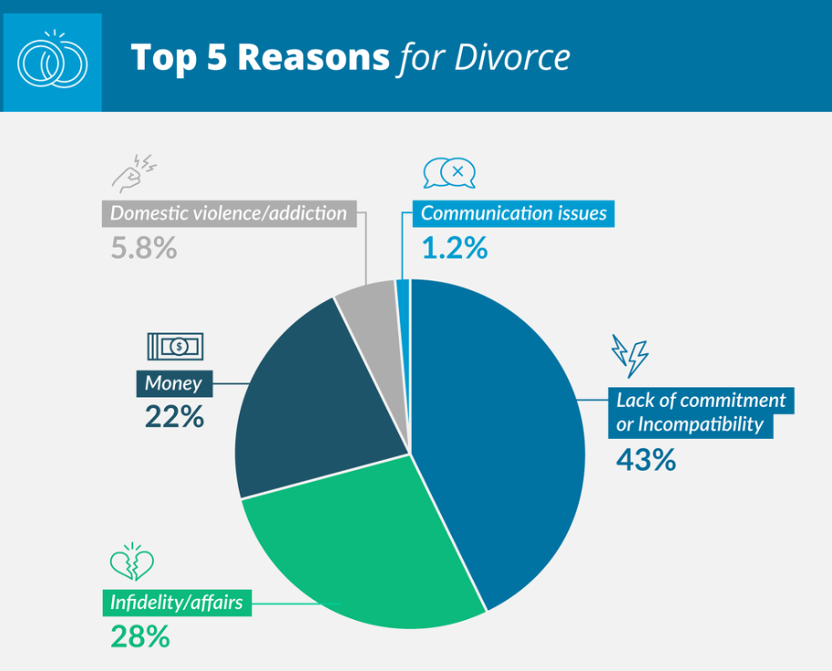
Divorce rate by Cause According to the Institute for Divorce Financial Analysts, the number one reason for divorce in America is “basic incompatibility.” 43% of research participants cited this reason as their primary decision to get a divorce. Infidelity and money issues were also highly relevant, with statistics showing that 28% and 22% of participants cited these reasons for obtaining a divorce. Parenting differences, lack of commitment, addiction, and abuse are commonly cited, too.

Slide 9
Divorce rate by Occupation
The findings from the data shows that Divorce rate also varies based on occupation.
5 Professions with highest divorce rates:
Dancers – 43
Bartenders- 38.4
Massage Therapists – 38.2
Gaming Cage Workers – 34.6
Gaming Service Workers – 31.3
5 Professions with lowest divorce rates:
Farmers – 7.63
Podiatrists – 6.81
Clergy – 5.61
Optometrists – 4.01
Agricultural Engineers – 1.78

Slide 10
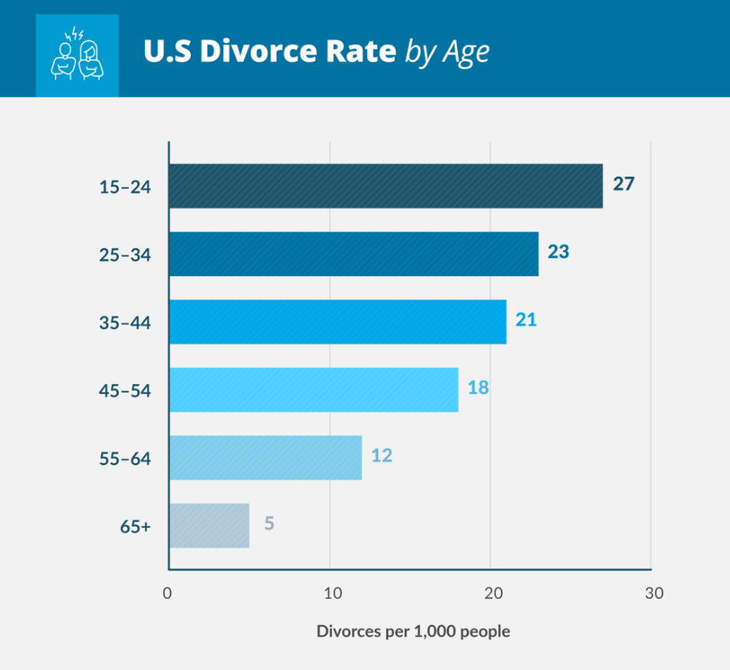
Divorce rate by Age Studies have shown that the age of the couple at the time of marrying does impact subsequent divorce rates. 48 % of those who marry before the age of 18 are likely to divorce within 10 years, compared to 25 percent of those who marry after the age of 25. 60 % of couples married between the age of 20 -25 will end in divorce. Those who wait to marry until they are over 25 years old are 24 % less likely to get divorced.

Slide 11
Analysis
We can apply some algorithms (like cluster analysis) to all this data and make some derivations/draw some insights.
Even without any algorithms, If we look at the states with highest divorce rate, we find that the population is high with people belonging to the ethnicity with high divorce rate or those states have opportunities for occupations which have high divorce rates.
Example: Vegas had a high divorce rate. Here, the age group of the couples getting divorce is less (young), - they get married hastily, Dancers are high in numbers in Vegas, the occupation, which has high divorce rate. Hence, It is very evident that age and occupation has a great impact on the divorce rate.

Slide 12
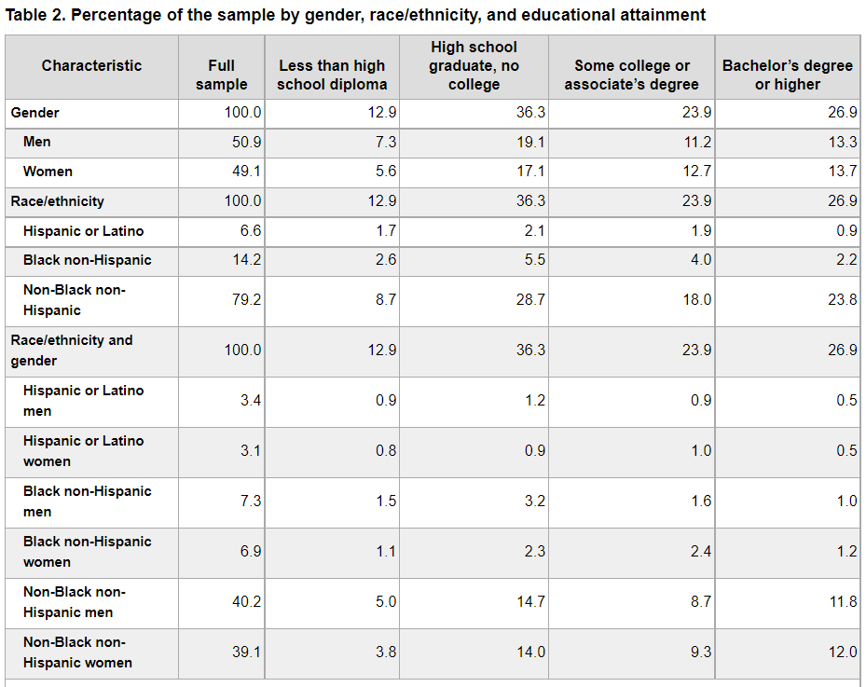
Analysis Cont’d This chart shows an analysis by race/ethnicity, age and education attainment. Whites are about twice as likely as Blacks and Hispanics to have earned a bachelor’s degree.
Based on the data collected, and the analysis made, it is evident that Culture, lifestyle, demographics , all have a significant influence on the divorce rate.
.

Slide 13
Conclusion
Based on the data collected, and the analysis made, it is evident that Culture, lifestyle, demographics , age and education attainment, all have a significant influence on the divorce rate.
.

Slide 14
Resources
Resources:
These Are The States With The Highest / Lowest Divorce Rates By 30 – Zippia
Divorce Rate in America: 35 Stunning Stats for 2022 (legaljobs.io)
Divorce Rate by State 2022 (worldpopulationreview.com)
The Growing Racial and Ethnic Divide in U.S. Marriage Patterns - PMC (nih.gov)
Divorce Statistics and Facts | What Affects Divorce Rates in the U.S.? (wf-lawyers.com)
https://www.cdc.gov/nchs/pressroom/02news/div_mar_cohab.htm
http://www.census.gov/population/www/socdemo/marr-div.html

